Slide 1

Histology of muscle tissue

Slide 2
Objectives
Skeletal muscle
Cardiac muscle
Smooth muscle

Slide 3
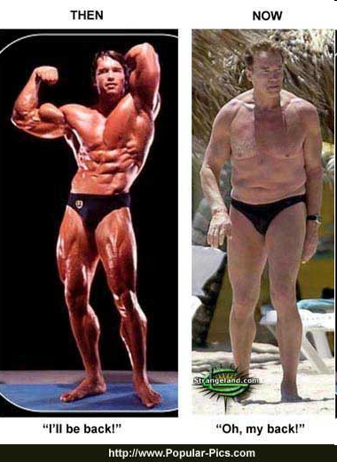
Muscle Function
Movement
Respiration (diaphragm, intercostals)
Communication (verbal/facial)
Thermogenesis
Heart beat
Constriction of organs/vessels
Protection eg abdominal viscera
Posture Maintenance
Joint Stabilization
Stronger muscles = greater protection, increased joint stability

Slide 4
Universal Properties of Muscle
Excitability: capacity of muscle to respond to a stimulus
Contractility: ability of a muscle to shorten and generate pulling force
Extensibility: muscle can be stretched back to its original length
Elasticity: ability of muscle to recoil to original resting length after stretched

Slide 5
Types of Muscle
Skeletal
Attached to bones
Makes up 40% of body weight
Responsible for locomotion, facial expressions, posture, respiratory movements, other types of body movement
Voluntary in action; controlled by somatic motor neurons
Smooth
In the walls of hollow organs, blood vessels, eye, glands, uterus, skin
Some functions: propel urine, mix food in digestive tract, dilating/constricting pupils, regulating blood flow,
In some locations, autorhythmic
Controlled involuntarily by endocrine and autonomic nervous systems
Cardiac
Heart: major source of movement of blood
Autorhythmic
Controlled involuntarily by endocrine and autonomic nervous systems

Slide 6
Skeletal muscle

Slide 7
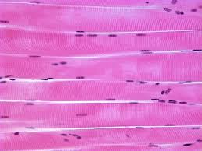
Skeletal muscle
Cylindrical
Multinucleated
Nuclei at periphery
Cross striations

Slide 8
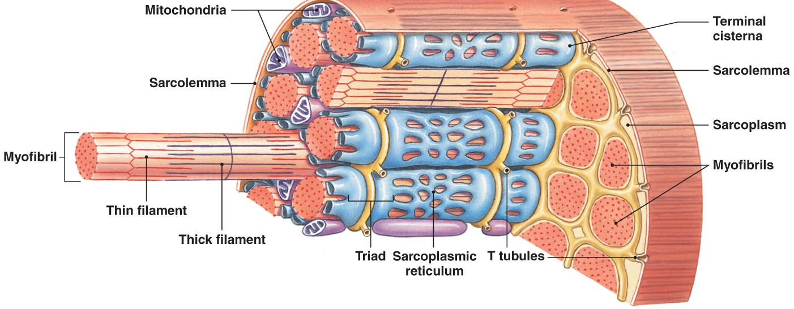
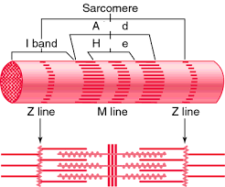
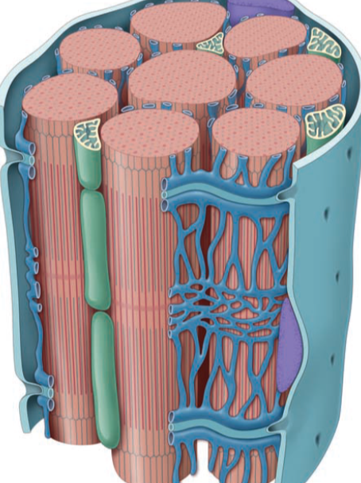
Skeletal Muscle Fiber
Notes:
Internal Organization of Muscle Fibers
The sarcolemma
The cell membrane of a muscle fiber (cell)
Surrounds the sarcoplasm (cytoplasm of muscle fiber)
A change in transmembrane potential begins contractions
Transverse tubules (T tubules)
Transmit action potential through cell
Allow entire muscle fiber to contract simultaneously
Have same properties as sarcolemma
Myofibrils
Lengthwise subdivisions within muscle fiber
Made up of bundles of protein filaments (myofilaments)
Myofilaments are responsible for muscle contraction
Types of myofilaments:
thin filaments:
made of the protein actin
thick filaments:
made of the protein myosin
Sarcoplasmic reticulum (SR)
A membranous structure surrounding each myofibril
Helps transmit action potential to myofibril
Similar in structure to smooth endoplasmic reticulum
Forms chambers (terminal cisternae) attached to T tubules
Triad
Is formed by one T tubule and two terminal cisternae
Cisternae:
concentrate Ca²⁺ (via ion pumps)
release Ca²⁺ into sarcomeres to begin muscle contraction

Slide 9
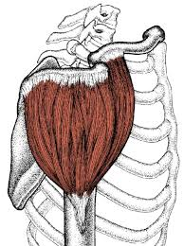
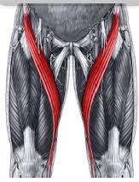
Adaptations of skeletal muscles
Nuclei at periphery: max interaction of actin & myosin
Multinucleated: genetic material for synthesis of actin & myosin
Some have many fibers (multipennate): greater force of contraction
Some have longer fibers: greater range of shortening

Slide 10
Clinical significance of skeletal muscle

Slide 11
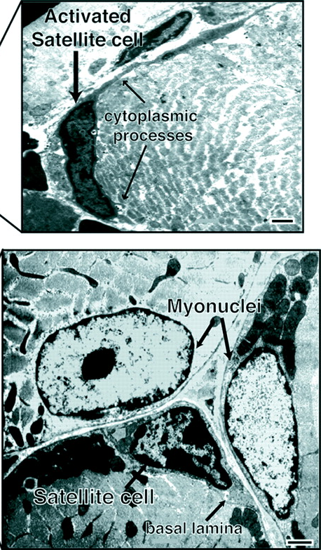
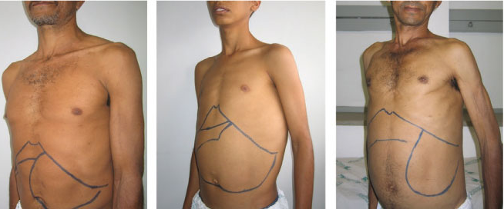
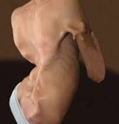
The myosatellite cell
Myositis ossificans

Slide 12
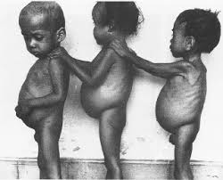
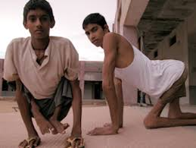
FACTORS INFLUENCING GROWTH OF MUSCLE:
Nutrition
Innervation
Exercise
Hormones: testosterone lead to muscle growth

Slide 13
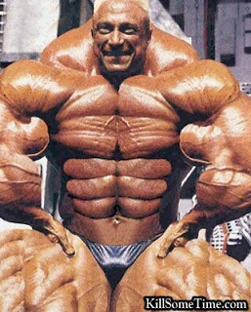

Slide 14
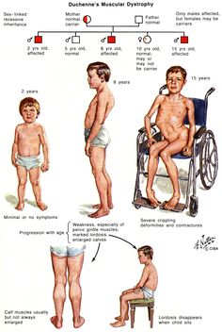
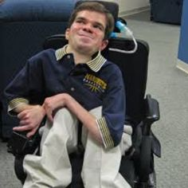
Duchenne muscular dystrophy

Slide 15
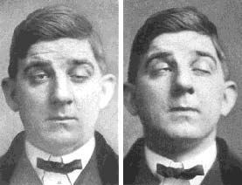
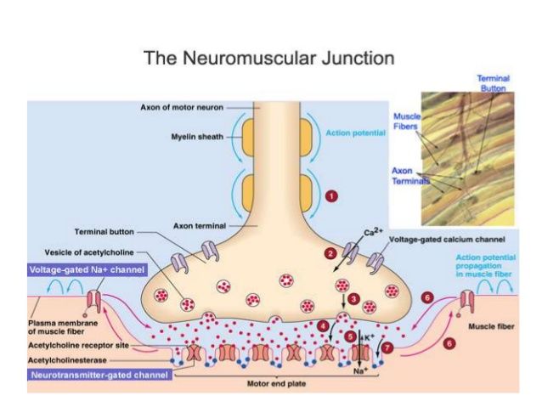
Myasthenia Gravis

Slide 16
Cardiac muscle

Slide 17
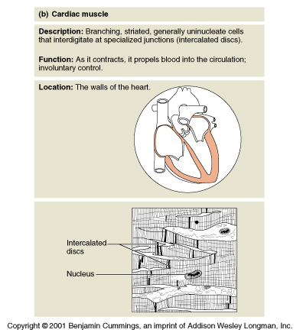
Cardiac Muscle
Branching cells
One/two nuclei per cell
Striated
Involuntary
Medium speed contractions
Notes:
Cardiac muscle tissue is only found in the heart. *Cardiac cells are arranged in a branching pattern. * Only one or two nuclei are present each cardiac cell. *Like skeletal muscle, cardiac muscle is striated. *Cardiac muscle is involuntary. *Its speed of contraction is not as fast as skeletal, but faster than that of smooth muscle.

Slide 18
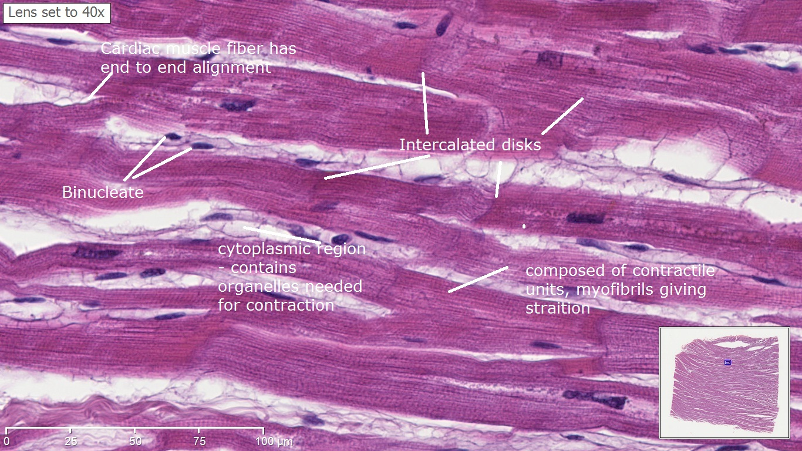
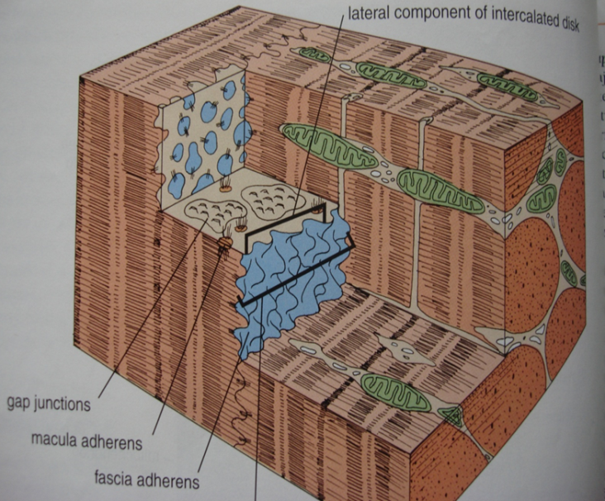
Cardiac muscle histology

Slide 19
Adaptations of cardiac
Abundant mitochondria
Wider T-tubules
Extensive gap junctions
Branching cells connected by intercalated discs
Macula adherence to prevent cardiac cells from separating
Cardiac muscle forms DIADS instead of TRIADS

Slide 20
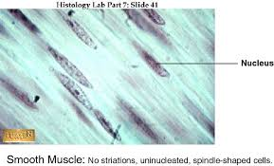
Smooth muscles

Slide 21
Universal features of smooth m.
Fusiform cells
One nucleus per cell
Non-striated
Involuntary
Slow, wave-like contractions
Gap junctions
The larche phenomenon
Caveolae instead of T-tubules
Dense bodies instead of Z-lines

Slide 22
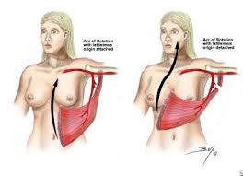
General concepts of muscle
Muscles with Segmental blood supply
Muscles with Dual innervation

Slide 23
Dual innervation
Upper limb | Lower limb
Pec major | Pectineus
Brachialis | Magnus
FDP | Biceps femoris
Relevance: can be split without denervation

Slide 24
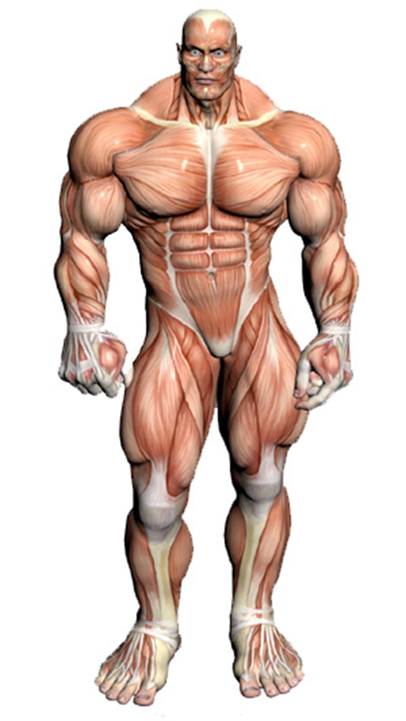
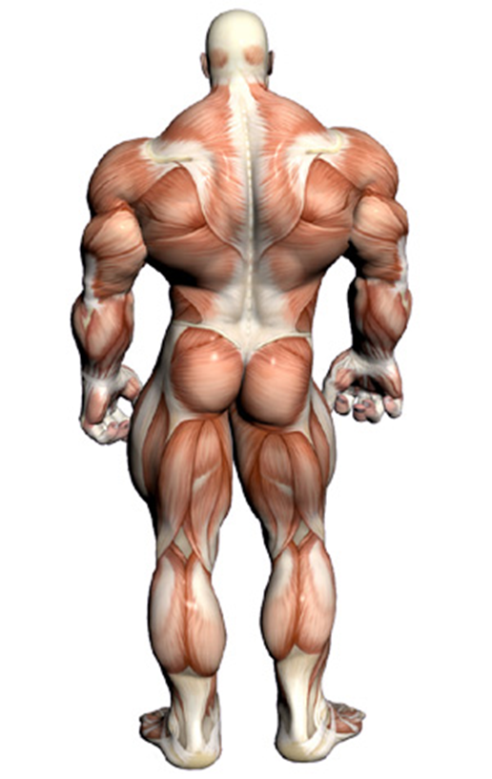
The end

